Slide 1
KeyLoGGER KeRnel MODULE
Devansh Kaushik M210680CA
Anuj Singh Kushwaha M210661CA
Vatsala Hemdan M210660CA

Slide 2
ACKNOWLEDGEMENT
We deem it a pleasure to acknowledge our sense of gratitude to our project guide Dr. Jayaraj P B, Professor-in-charge under whom we have carried out the project work on the topic Keylogger Kernel Module. His incisive and objective guidance and timely advice encouraged us with constant flow of energy to continue the work.
We wish to reciprocate in full measure the kindness shown by Dr. Subhasree M(H.O.D., Computer Science and Engineering) who inspired us with his valuable suggestions in successfully completing the project work.
We shall remain grateful to Prof. Prasad Krishna, Director, National Institute of Technology Calicut, for providing us a strong academic atmosphere by enforcing strict discipline to do the project work with utmost concentration and dedication.
It was a great learning experience and helped us in understanding various Linux kernel concepts.

Slide 3
PRojEcT DescRiption
Keylogger is a stealthy Linux kernel-based module. It is a loadable kernel module that hides itself from ‘lsmod’ command and /proc/modules. It captures the keystrokes of the keyboard and outputs to a character device driver. Using ‘rmmod’ command, an error is displayed showing no such module is running in the kernel. To remove the keylogger module, ‘make clean’ command can be used.

Slide 4
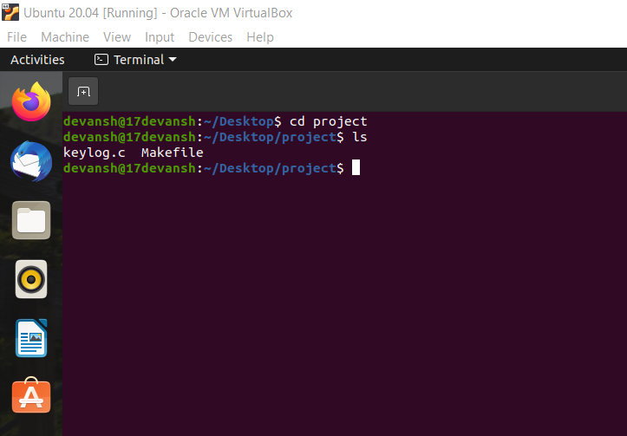
Steps To Run THE MODULE
1. Open Linux Terminal and go to the directory where C file and Makefile is present using cd command.

Slide 5
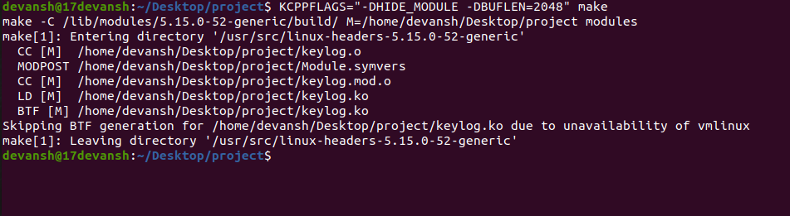
Now we will use the ‘make’ command to invoke the execution of the Makefile.
We will use ‘-DHIDE_MODULE’ to hide kernel module from lsmod command.

Slide 6
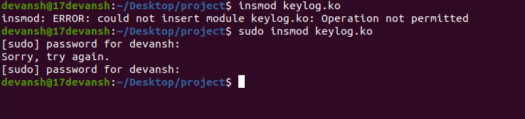
3. Check if .ko file is present or not by using ‘ls’ command.
4. Now we will insert our module into kernel by using ‘insmod’ command. If we are not working as administrator we have to use ‘sudo’ command for having all permissions.

Slide 7

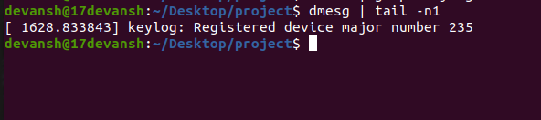
5. Now we will use ‘lsmod’ command along with ‘grep’ filter to check if the ‘lsmod’ command is displaying the hidden module or not.
6. After this we will use ‘dmesg’ command along with ‘tail’ filter to get the major number.

Slide 8
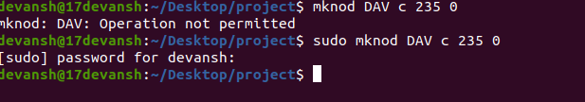
7. After this we will create a character file which will store the keylog of our system with the help of ‘mknod’ command . If we are not working as administrator we will use ‘sudo’ along with the above command.
Note : The below command will store our keylog in a file named DAV.

Slide 9
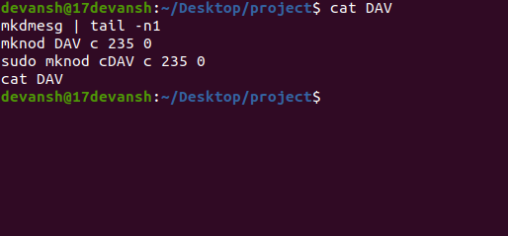
8. We can view the file content (keylogs) by using ‘cat’ command.
Our keylog history will be displayed on the terminal.

Slide 10
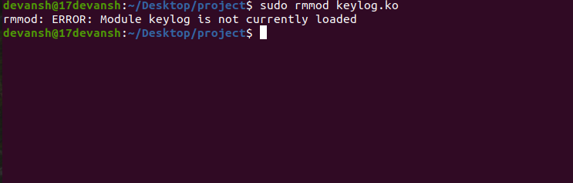
9. Now to remove the module we will try ‘rmmod’ command and see if it works or not.
If we are not working as administrator we will use ‘sudo’ command along with the above command. The command will give error as the module is hidden.

Slide 11
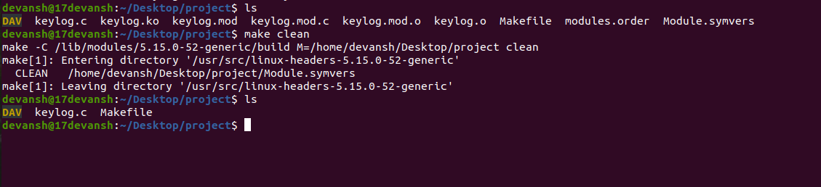
10. We will use the ‘make clean’ command to remove the module from workspace. It will clear all the files which were created by ‘make’ command. We can check by using ‘ls’ command before and after giving ‘make clean’ command.
Note: We can use ‘sudo –i’ command to at the start initially to work as root (having all permissions and access) and avoid typing ‘sudo’ command repeatedly

Slide 12
Thank You!

